Slide 1
Relationship Between GDP and CO2 Emissions
By Manoj Dey, Hamed Yazarloo, and Gautam Gupta

Slide 2
Data Used
https://data.worldbank.org/

Slide 3
Website Navigation
(opening website and walkthrough)
http://localhost:8000/bootcampProject/misc/CO2emission.html
Key Points
The trend noticed was that during the greatest increases of gdp, CO2 emission also increased, overtime
There is a strong co relation between gdp and CO2 emission

Slide 4
Git-Hub view of Raw Codes
https://github.com/manojkdey/bootCampFinalProject/tree/master/bootcampProject

Slide 5
Machine Learning in Granule Detail

Slide 6
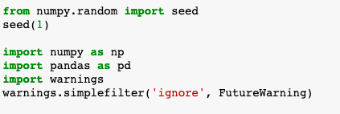
Libraries
Notes:
Imported pandas and numpy

Slide 7
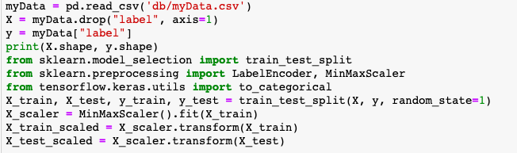
Data Pre-Processing
X and y shapes:
(2143, 5) (2143,)
Notes:
We divid4ed the data frame into two parts: first one is captial X, second one is y. Cpatial X is year CO2 emissions per capita, gdp per capita, and population and year. Y is country names. Then we split the data into train data and then test. Then we scaled the data.

Slide 8

Label-encode data set
Notes:
We did encoding for Y.

Slide 9
Convert encoded labels to one-hot-encoding
Notes:
(continued)

Slide 10
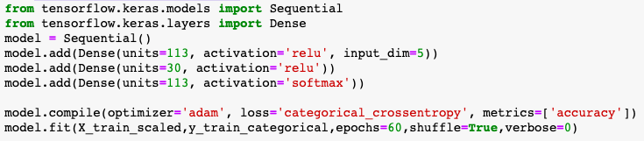
Create a Deep Learning Model
Notes:
Then we created deep learning model using Tensor flow library keras module. Our first layer in input dimensions this is the number of columns in capital X. Our data when we imported it has 5 columns for capital X and one column for Y.

Slide 11
Quantify our Trained Model
536/536 - 0s - loss: 1.4021 - acc: 0.5392 Normal Neural Network - Loss: 1.4021, Accuracy: 0.5392
Notes:
Then we compiled it and fit the model . And we got 54% accuracy of the model, the model shown in 3 layers.

